Slide 1
UE18CS390A – Capstone Project Phase – 1
Project Progress Review #3
Project Title :Forecasting future trending topics using text data.
Project ID : PW22DS03
Project Guide : Dinesh Singh
Members : Kavishankar K S PES1201802001
Mohammed Zeeshan PES1201801814
Rohan M PES1201801798

Slide 2
Abstract and Scope
Problem Statement:
Discovering trending topics from social media platforms and Forecasting the future trends based on the recent and past trend of the topics collected.

Slide 3
Abstract and Scope
Abstract:
Youtube Video Sharing System is often figures among the top 3 most popular application on website .
It has been reported Youtube users upload 72 hr videos / min.
So ,Forecasting content popularity is of great support and drive for design and management of various services.
our project is towards building ML model to forecast popular online content, using Various technique .
For this project we use past trending topic train ford trending You, Groog! Me model with future contine
Forecasting the future trending topics by using the recent and past trend data from social media sites like twitter, youtube and with the help of google trends.

Slide 4
Abstract and Scope
Scope:
Our goal is to create a model that can help influencers predict the number of views for their next video. Content on Youtube covers a broad range of genres such as comedy, sports, fashion, gaming and fitness.
Helps for the business decision R&D part of company to predict the future trends.
For content creators on youtube or writing blogs or
posts.
Decisions which are made based upcoming trends.
Products that are customised based on trend.

Slide 5
Suggestions from Review - 2
Review-1
Extend project to some extent since its seems to simple at first glance.
Better name to topic as initial one is so general.
Review-2
Points in the ppt should not much elaborative.
Development of Better Model for forecasting.

Slide 6
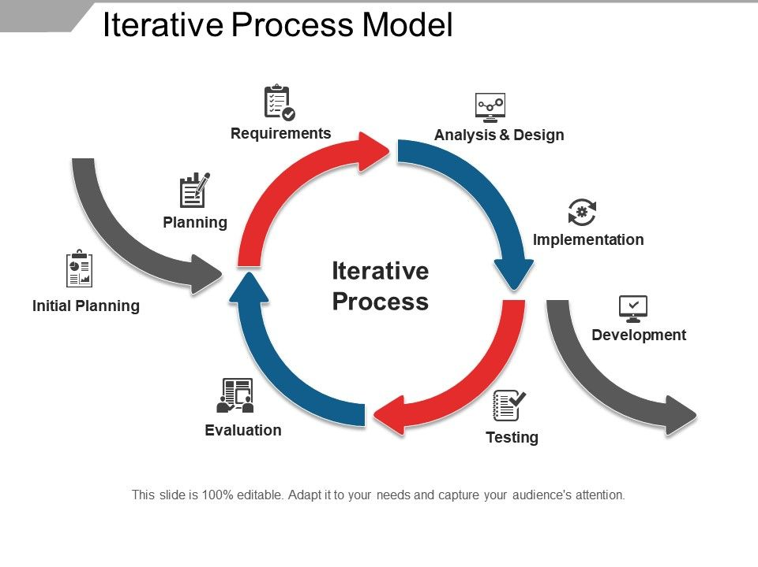
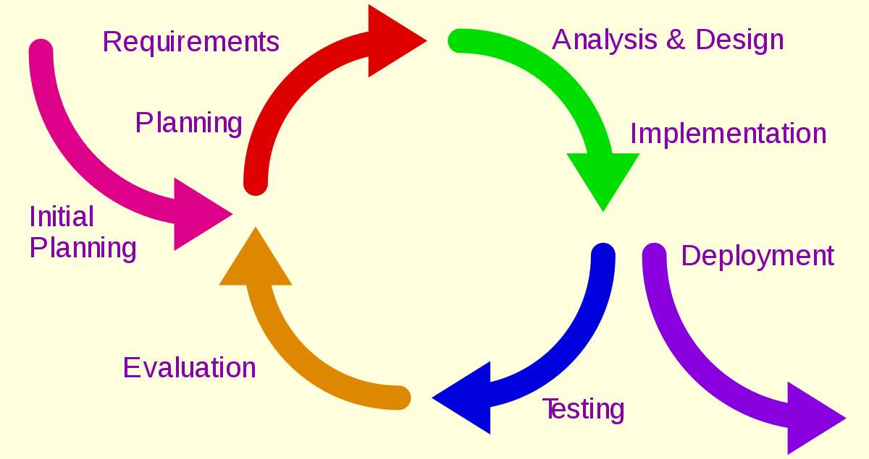
Design Approach
An iterative life cycle model does not attempt to start with a full specification of requirements
In the Iterative model, iterative process starts with a simple implementation of a small set of the software requirements and iteratively enhances the evolving versions until the complete system is implemented and ready to be deployed.
For every cycle we update our requirements and implement according to requirements.
Iterative development.

Slide 7
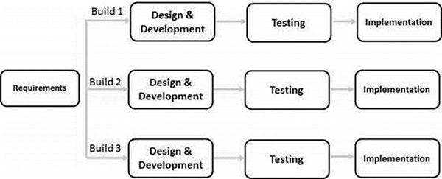
Design Approach

Slide 8
Design Constraints
Design Constraints:
As our project is based on real time data.For every result preprocessing and extraction of data is required.
Since we are using ML models to predict the future trends, we may need huge time and high computational power if we use large datasets to train the model.
A lot of time is consumed if we want to make changes to the model depending on the circumstances, since training the model requires a large amount of time.
We are dealing with text data which is indeed a big constraint since we can’t work on it, so we have to convert into some form before any process.
Extent of forecasting.

Slide 9
Assumptions
Assumptions:
The trending topics in future are based on the current and past trend.
The frequency of occurrence of topics is helps in predicting it’s trend.
Accuracy of chosen model is high.
Topics are low resolution and high sensitive.
Rising and falling of the topic do not have a long term spanning.

Slide 10
Confounding variables in data.
Effects the both dependent and independent variable.
Correlation between topics.
Extent of relation between each topic.
Data Quality .
Large dataset and useful features in the dataset.
Temporal dependency.
Casual relationship b\w the topics.
Dependencies

Slide 11
Literature survey
Paper 1:Topic discovery and future trend forecasting for texts
They used predict the next trending research topics based on corpus of research paper collected.
sentence-level pattern mining to discover meaningful topics.
Preprocessing using association analysis and LSA.
Used “WEKA” plugin which uses regression model for prediction.

Slide 12
Literature survey
Paper 2: Forecasting Time Series Data Using Hybrid GREY Neural Network And ARIMA Model.
In this study,a combination of GRANN ARIMA is proposed as a new approach for hybridizing linear and nonlinear models.
The proposed model has few integrated features such as engaged with multivariate time series data.
Forecasting accuracy of the proposed hybrid model, GRANN ARIMA is better compared to the individual model such as GRANN, ARIMA, MR and the second order error, LVM.

Slide 13
Literature survey
Paper 3: Using Early View Patterns to Predict the Popularity of YouTube Videos
In this study Multivariate Linear (ML) Model , MRBF Model and S-H Models are used to predict future trends in youtube.
By assigning different weights to different popularity samples within the monitoring period, our model is able to better distinguish between videos with different popularity evolution patterns, which leads to significant reductions in average prediction errors.
We also found that by exploring the similarity between the video and known examples from the training set through RBF functions, we are able to reduce prediction errors even further, by adapting the prediction to better handle some specific kinds of videos.

Slide 14
Proposed Methodology/Approach
Data Extraction:
Web scraping
Using API's- provided by different social media platforms mainly from twitter, google trends and YouTube.
2. Preprocessing
Normalisation- remove noise from the data.
Removal of:
stop words:Commonly occurring words.
stemming: reducing word into root form.
3. Text Classification:
NLP: classifying the topic to domain it belongs
Pattern/rule based classifier.
SVM classifiers.
Word2vec.

Slide 15
Proposed Methodology /Approach
4. Future Selection for text classification:
Optimizing a model by selecting a subset of the features to use.
Reducing the overfitting of the dataset.
Wrapper method-Wrapping methods compute models with a certain subset of features and evaluate the importance of each feature.
5. Forecasting and modelling :
Poison process:
variation of the particular topic over the time period.
Markov chain:
trend analysis over period of time.
Apriori algorithm- Conversion of transaction into frequent item set.
Hybrid Model - for forecasting the trends.
Clustering for violation detection.

Slide 16
Proposed Methodology /Approach
6.Testing
RMSE:
The model accuracy is evaluated using the RMSE.
7.Interpreting the result.
Visual graphs.
Future Trend Score.

Slide 17
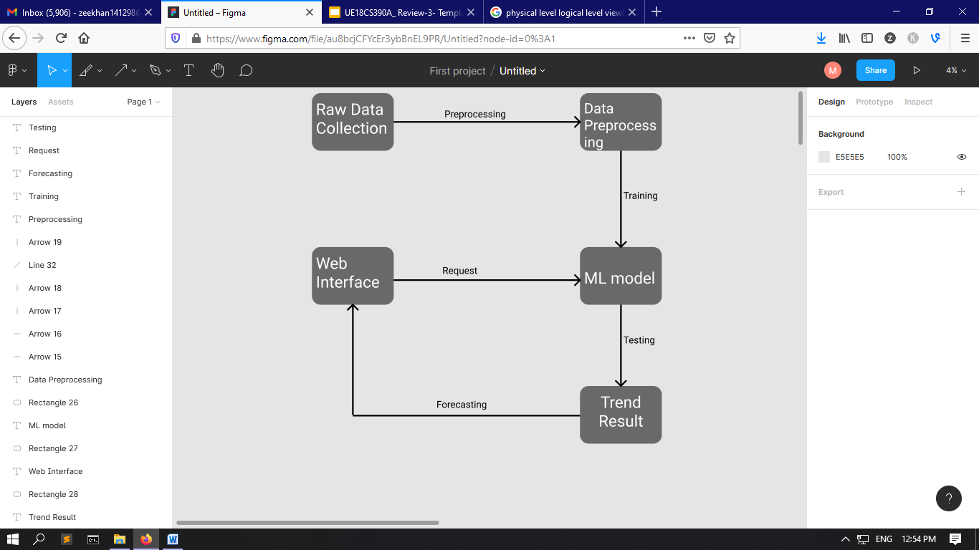
Architecture
Flow Diagram

Slide 18
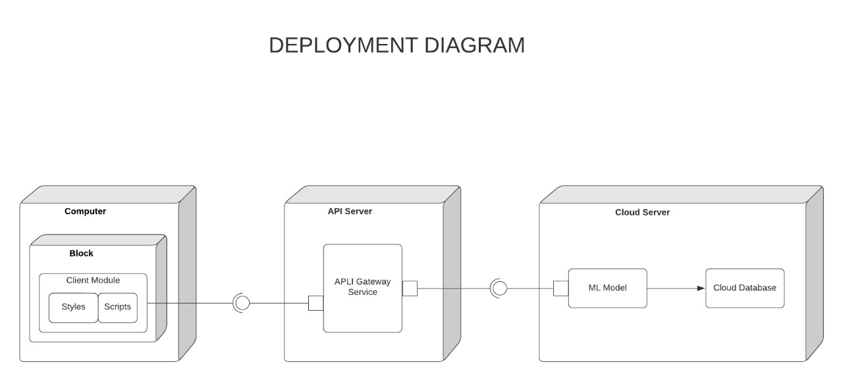
Architecture

Slide 19
Design Description
Master class diagram
ER Diagram
User Interface Diagrams/ Use Case Diagrams

Slide 20
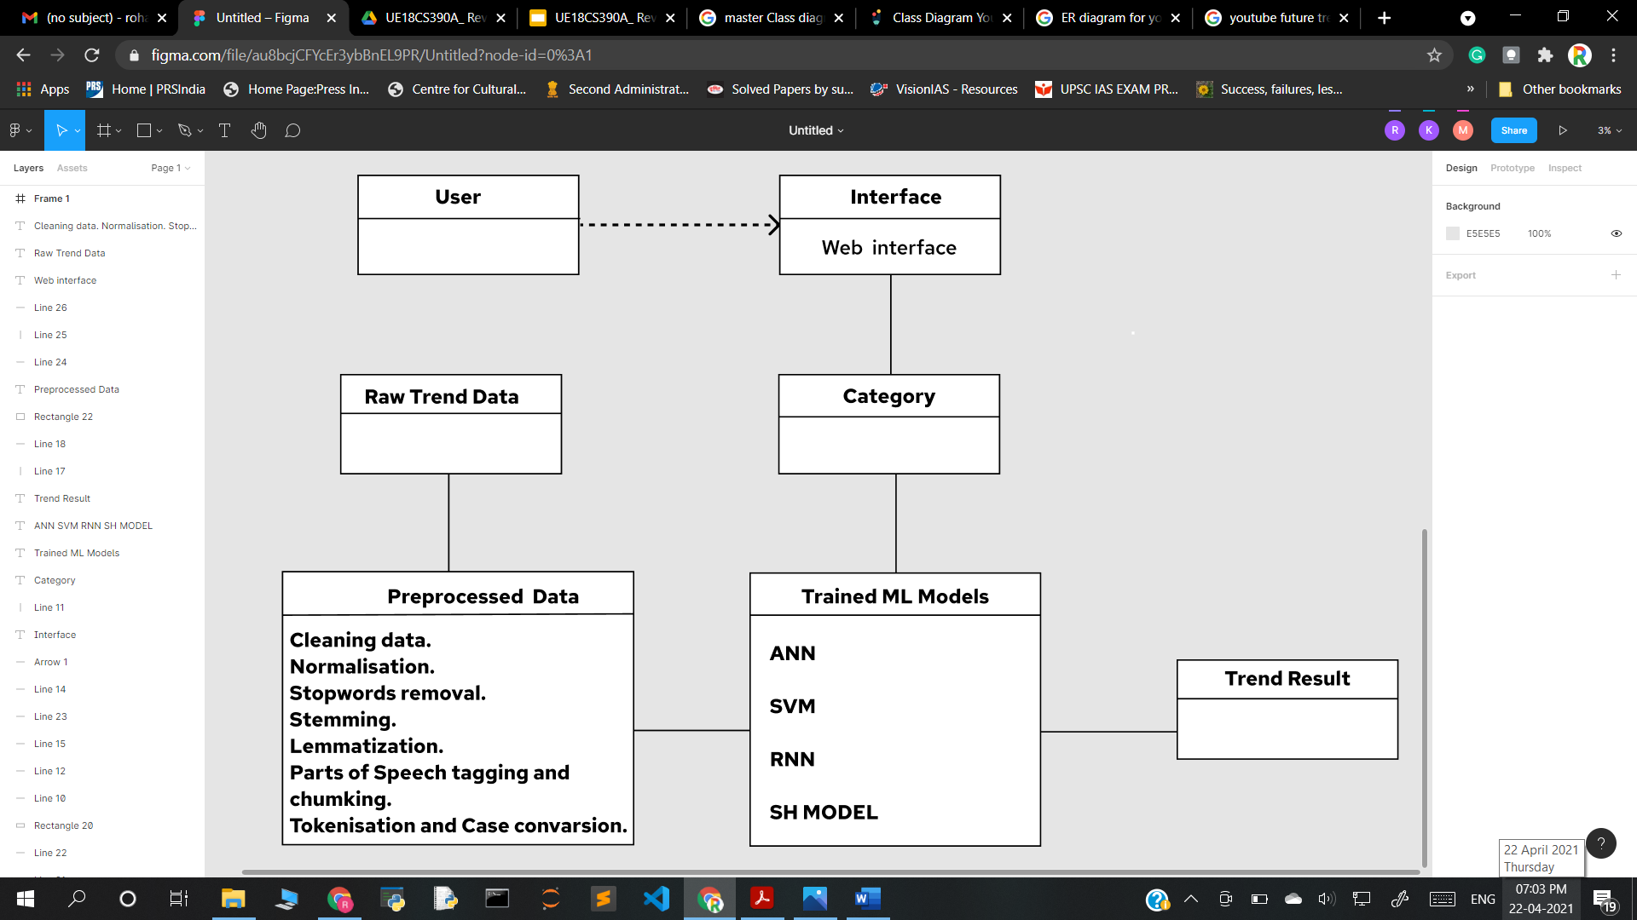
Master Class Diagram

Slide 21
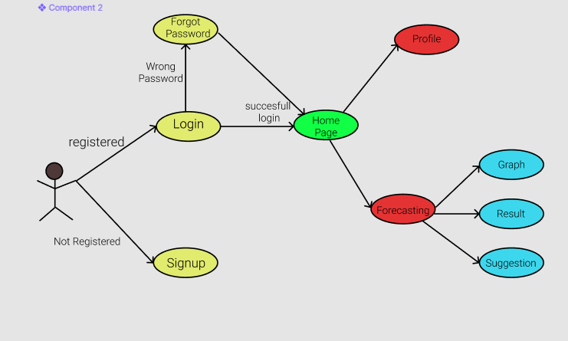
2. User Case Diagram

Slide 22
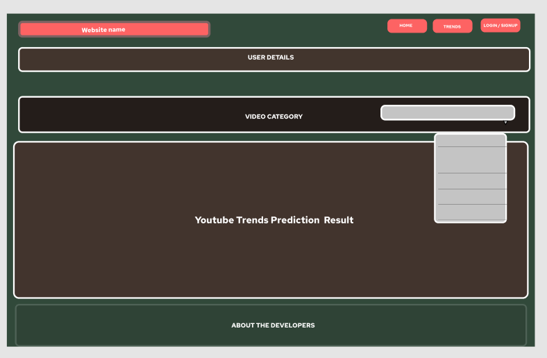
3. User interface Diagram

Slide 23
Technologies Used
Data Extraction:
Using the web scraping.
Python Beautiful Soup.
Using the api’s provided by specific social media websites.
Twitter Developer API
Youtube API
Google Trends API
Data preprocessing:
Using NLP techniques.
Normalisation.
Stopping and Stemming.

Slide 24
Technologies Used
Forecasting:
Methodes
Statistical mode
Artificial Intelligence
Data analytics techniques.
ARIMA
MR
Hybrid model
GRAN-ARIMA.
Visualization tools:
Generating real time graphs.
Python Libraries like matplotlib and Pyplot.
WordCloud
Generating cloud of words.

Slide 25
Technologies Used
Flask:
Web application
Machine learning model deployment.
Data Storage
Storing data in cloud.
Testing
Pycharm.
Jupyter.
Google Colab.

Slide 26
Project Demo
Pseudocode :
1.Extract data from social networks using web scraping and api’s.
2.Preprocess Data using NLP and Normalisation ,Removal of POS, stop words, stemming etc.
3.Using extracted Data build a model for training
4.Train the model.
5.Test the trained Model and update the model as required.

Slide 27
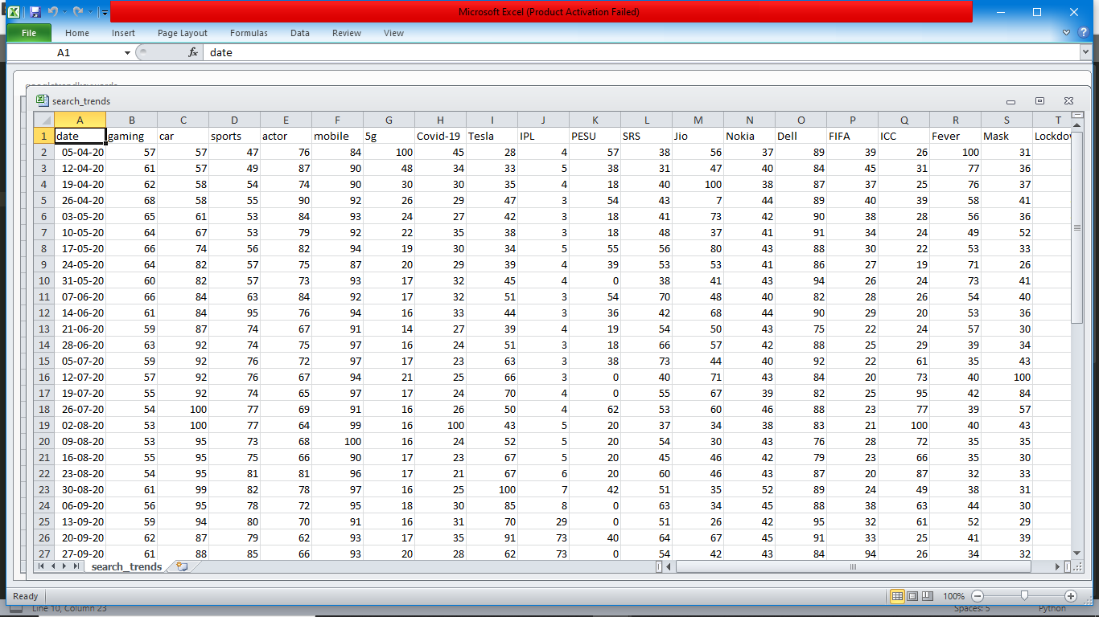
Search Data Extracted From Google Trends using API :

Slide 28
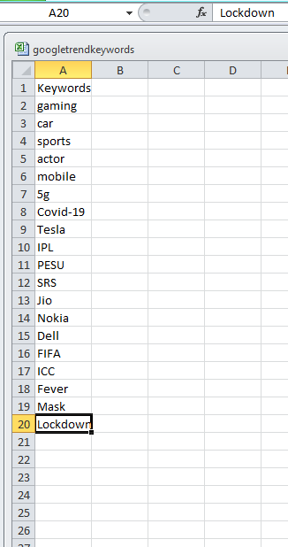
Keywords used.

Slide 29
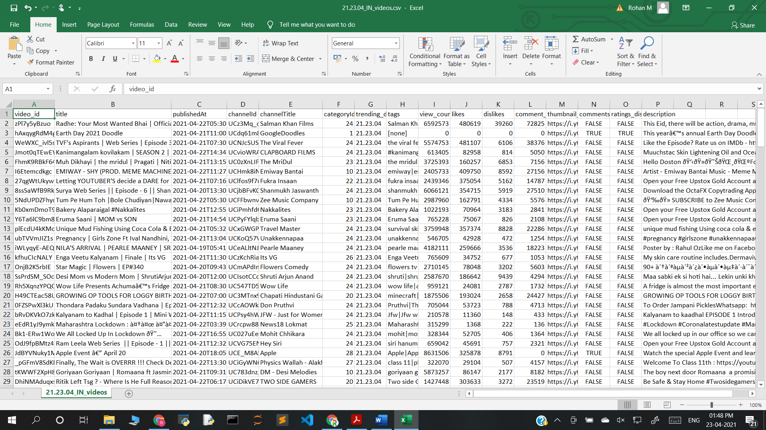
Search Data Extracted From Youtube using API :

Slide 30
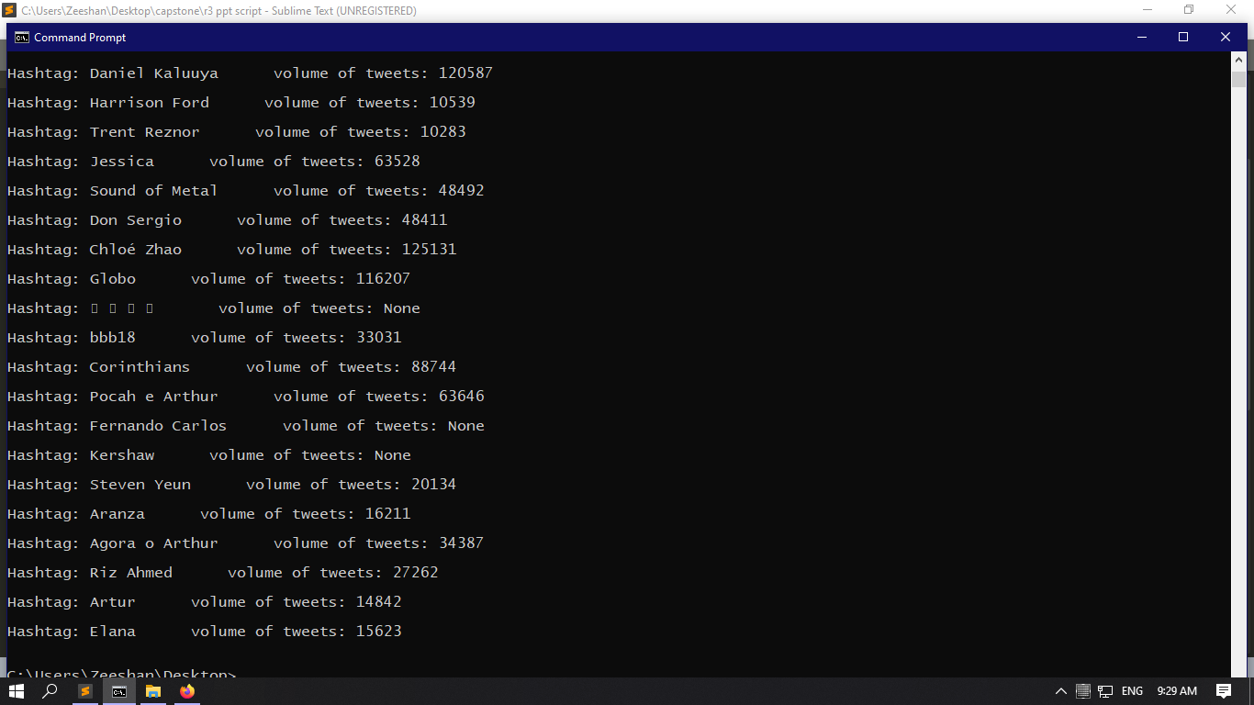
Data extracted from twitter trends :

Slide 31
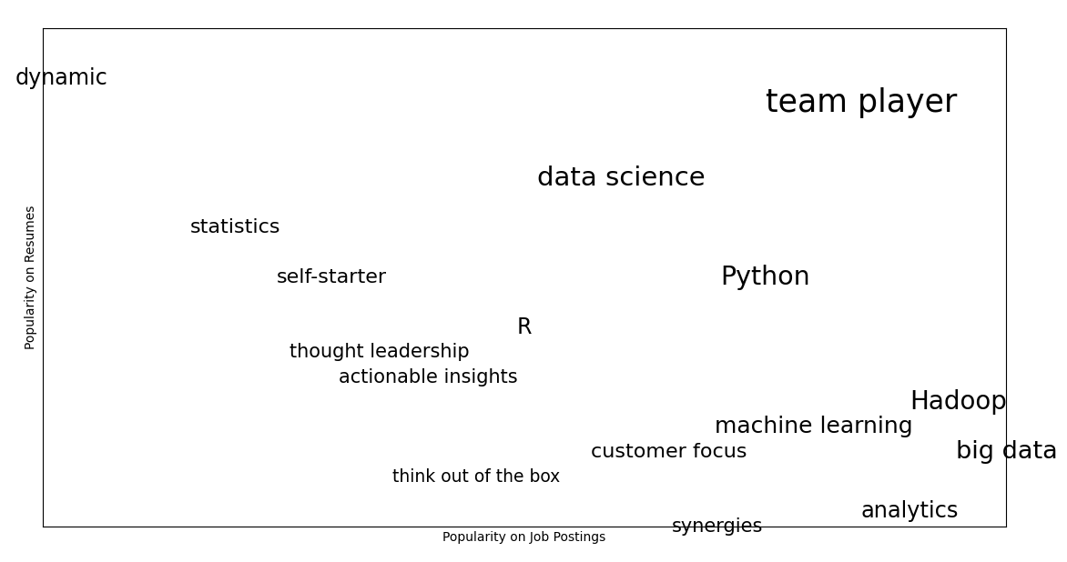
Word Cloud :

Slide 32
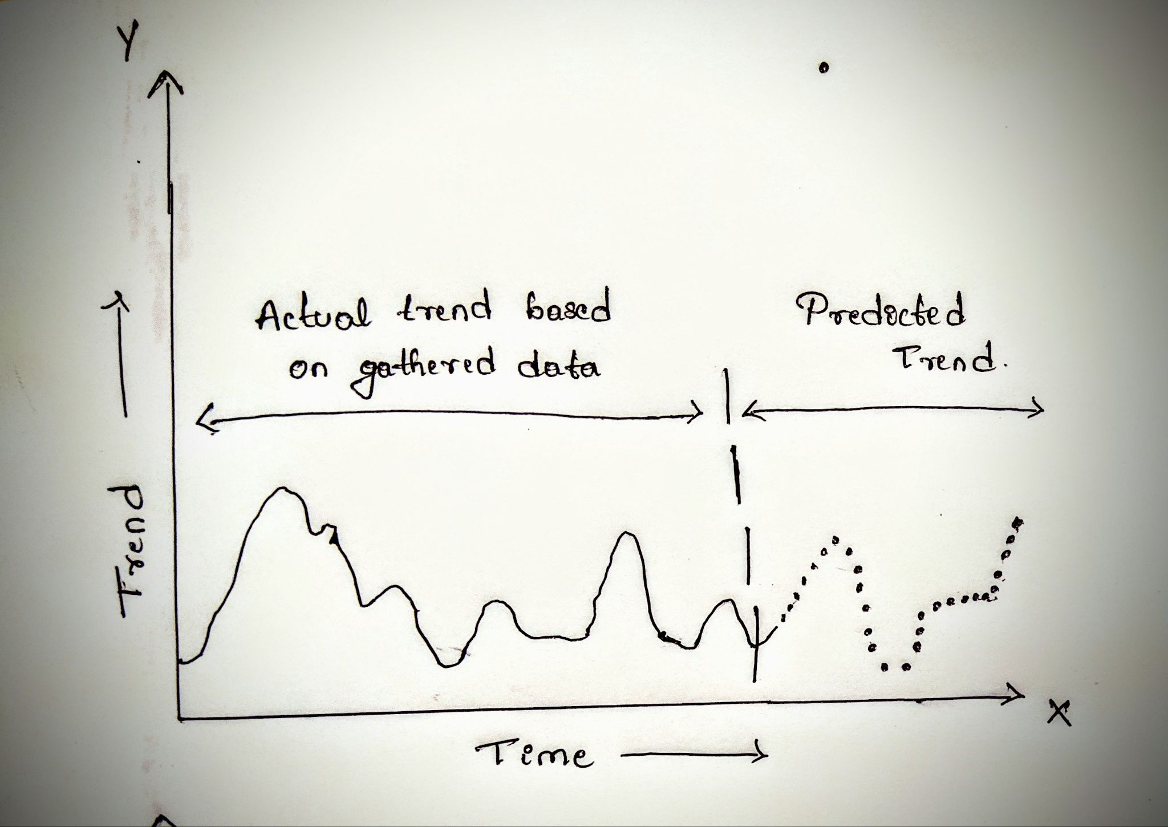
Final interpretation of result

Slide 33
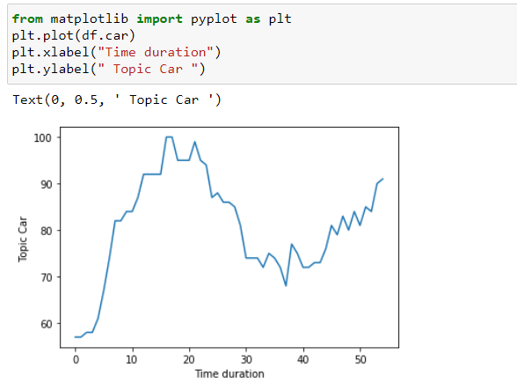

Slide 34
Project Progress
1. Data collection using web scraping and API’s of social networking
platforms.
2. Preprocessing of data.
3. Currently working on choosing and building Machine Learning
Model,based on the literature survey .
4. Analysis of Gathered data.
About 30% of the project has been completed till now.

Slide 35
Future works
Building ML model based on the literature survey done.
Training the model with extracted and preprocessed data.
Testing the Model.
Creating user interface.

Slide 36
Extending works
Finding the possible violation may arise from trending topics.
Consequences and ramifications produced by future trending topic.

Slide 37
References
References:
Jose L. Hurtado*† , Ankur Agarwal† and Xingquan Zhu†,
”Topic discovery and future trend forecasting for texts”
2. Roselina Sallehuddin, Siti Mariyam Hj. Shamsuddin, Siti Zaiton Mohd. Hashim,,Ajith Abrahamy, “Forecasting Time Series Data Using Hybrid GREY Neural Network And ARIMA Model”.

Slide 38
References
3. “YouTube View Prediction with Machine Learning”
Int. J. Business Information Systems, Vol. 13, No. 3, 2013 359
4. Conrad Tucker1 and Harrison M. Kim1 (1)
“PREDICTING EMERGING PRODUCT DESIGN TREND BY MINING PUBLICLY AVAILABLE CUSTOMER REVIEW DATA”.- University of Illinois at Urbana-Champaign, USA.
5.FORECASTING TIME SERIES DATA USING HYBRID GREY RELATIONAL ARTIFICIAL NEURAL NETWORK AND AUTO REGRESSIVE INTEGRATED MOVING AVERAGE MODEL Roselina Sallehuddin, Siti Mariyam Hj. Shamsuddin, Siti Zaiton Mohd. Hashim∗ , Ajith Abraham.

Slide 39
Thank You

